Slide 1
Foundation of Data Analytics
Stock Market Analysis
Review-3

Slide 2
Review Outline
ABSTRACT
INTRODUUCTION
ABOUT THE DATASET
OBJECTIVES
PROBLEM STATEMENT
LITERATURE SURVEY
TOOLS & TECHNOLOGIES USED
SYSTEM ARCHITECTURE
CODE IMPLEMENTATION
LIMITATIONS

Slide 3
Abstract
The Stock market process is full of uncertainty and is affected by many factors. Hence the Stock market analysis is one of the important exertions in finance and business. There are two types of analysis possible for prediction, technical and fundamental. In this project we will discuss about technical analysis they are
Simple Moving Average (SMA), Exponential Moving Average (EMA), Bollinger Bands (BBands) and MACD.
The Bollinger Bands are indicated volatility by upper and lower band of cost for simple moving average. Relative Strength Index is a momentum oscillator that indicates change of price movement and speed of stock. The moving average convergence divergence (MACD) is one of the most well known and used indicators in technical analysis. This indicator is comprised of two moving averages, which help to measure momentum in the security. Now the study two types of moving average measures which are: Exponential moving average and Simple moving average.

Slide 4
Introduction
Stock market is the bone of fast emerging economies such as India. Major of capital infusion for companies across the country was made possible only thru shares sold to people. So our country growth is tightly bounded with the performance of our stock market. The purpose of Bollinger Band is to determine high and low of stocks. Prices of stocks are high at upper band and low at lower band. Investor can take systematic trading decision by recognize the pattern of the stock. Relative Strength Index is a technical indicator determines strength and weakness of stock on closing price of a recent trading period.
The moving average convergence divergence (MACD) is one of the most well known and used indicators in technical analysis. This indicator is comprised of two moving averages, which help to measure momentum in the security. We will compare Exponential Moving Average based MACD with Simple Moving Average based MACD of technical analysis explains which method is better for the technical analysis based on moving average.

Slide 5
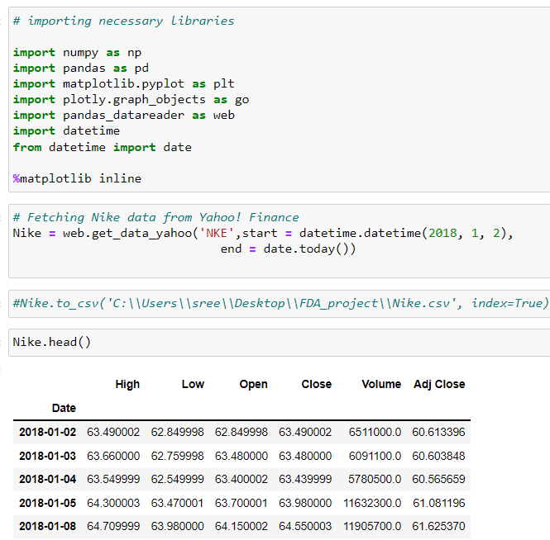
About the Dataset
Rather than taking dataset from different websites.
We fetched the Live Nike stock market data directly from Yahoo! Finance.

Slide 6
Objectives
The Main Objective is to analyze the historical stock market data using technical analysis methods like Simple Moving Average (SMA), Exponential Moving Average (EMA) , Bollinger Bands (BBands), Moving Average Convergence Divergence(MACD).
We will Analyze as a comparative study between those technical analytic methods and suggest the best method with proper reasons for future analysis and prediction on stock market.

Slide 7
Problem Statement
The basic strategy is to buy 100 stocks of Nike when the strategy generates a buy signal for any given indicator and sell 100 stocks after 'n' days. Technical analysis is done for predicting short term price momentum of any asset class; hence we've decided to hold the stock only for a short term (60 days). You can go for any number of days and see what works out best. We will demonstrate how to implement and back-test technical analysis trading strategies and not any investment advice.

Slide 8
Literature survey
S.No | Title | Author/ Journal | Techniques | Results
1 | A Comparative Study on Technical Analysis by Bollinger Band and RSI | Shah Nisarg Pinakin International Journal in Management and Social Science | BB (Bollinger Band)., RSI (Relative Strength Index). | Out of two methods Bollinger Band comparatively give good return and profit than RSI.
2 | Comparison Between Exponential Moving Average Based MACD with Simple Moving Average Based MACD of Technical Analysis | Naik Parth Pradipbhai IJSR - International Journal Of Scientific Research. | Exponential Moving Average based MACD, Simple Moving Average based MACD | EMA based MACD generates maximum profit and return compare to SMA based MACD.

Slide 9
Tools & Technologies Used
Jupyter Notebook :
Jupyter Notebook is a web application for creating and sharing documents that contain code, visualizations, and text. It can be used for data science, statistical modeling, machine learning, and much more.
Excel:
Analyze Data in Excel empowers you to understand your data through natural language queries that allow you to ask questions about your data without having to write complicated formulas.

Slide 10
System Architecture

Slide 11
NSE STOCK
Extract stock price
Evaluating return percentages
Simple Moving Average (SMA) strategy
Exponential Moving Average(EMA) strategy
Bollinger Bands
Moving Average Convergence-Divergence (MACD)
Comparing the two strategies
Computing 50 days SMA
Computing 200 days SMA
Computing 50 days EMA
Computing 200 days EMA
Bollinger Low
Bollinger High
Position MACD
If(SMA50>SMA200)
If(EMA50>EMA200)
Finding the best strategy
Buy
signal
Sell
signal
Buy
signal
Sell
signal
Buy
signal
Sell
signal
Buy
signal
Sell
signal
Back testing the strategies

Slide 12
Code Implementation

Slide 13
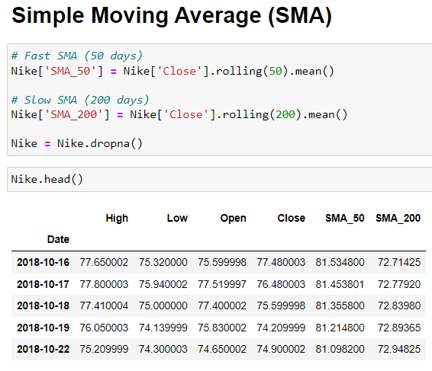
The basic strategy is to buy 100 stocks of Nike when the strategy generates a buy signal for any given indicator and sell 100 stocks after 'n' days. Technical analysis is done for predicting short term price momentum of any asset class, hence I've decided to hold the stock only for a short term (60 days).
Simple Moving Average is a technical indicator which calculates the average of 'Close' price of an underlying stock for a given period of time. eg. SMA_50 calculates the average of close price for the last 50 days.
Basic SMA strategy is that if the short term (fast) MA > long term (slow) MA, it's a signal to buy the stock. Similarly, if the short term (fast) MA < long term (slow) MA, it's a signal to sell the stock.

Slide 14
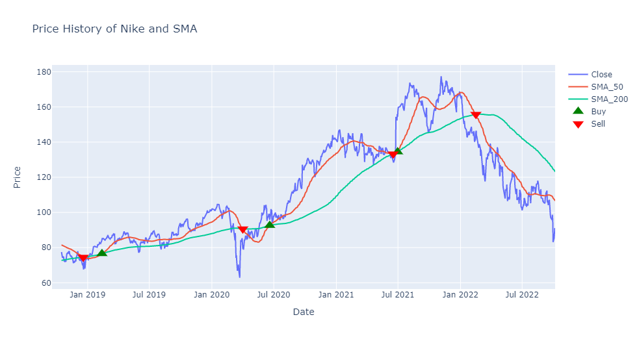
This is the plot for Trading Signals with SMA
The Green Up indicates us to buy the stocks whereas the Red Down arrow indicates to sell the stocks
This Analysis says that up to which price of the stock we can buy and sell.

Slide 15
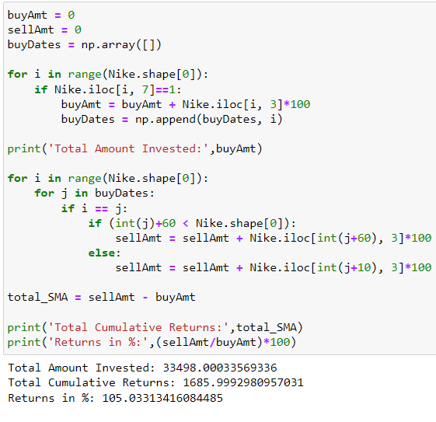
If we had followed this same strategy using SMA from 2018 till date, our total returns would be 105.03% i.e $10,000 invested using the same strategy would have generated $20,503 (as on 06/10/22).

Slide 16
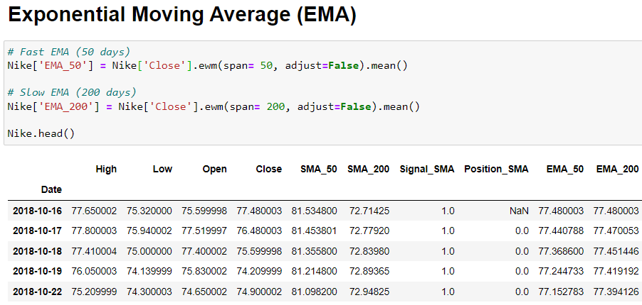
The exponential moving average (EMA) is a technical chart indicator that tracks the price of an investment (like a stock or commodity) over time. The EMA is a type of weighted moving average (WMA) that gives more weighting or importance to recent price data.
The exponential moving average is designed to improve on the idea of a simple moving average (SMA) by giving more weight to the most recent price data, which is considered to be more relevant than older data. Since new data carries greater weight, the EMA responds more quickly to price changes than the SMA.

Slide 17
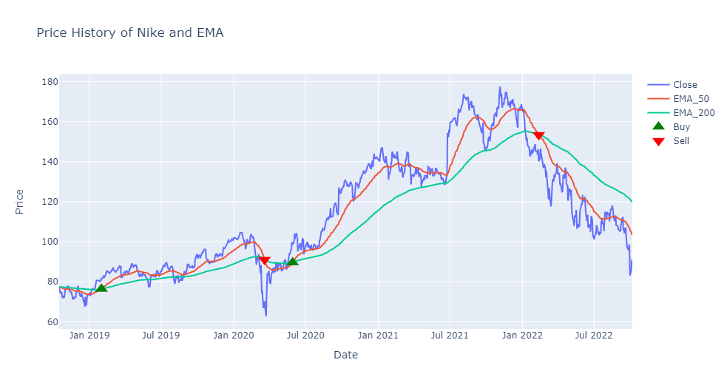
This is the plot for Trading Signals with EMA
The Green Up indicates us to buy the stocks whereas the Red Down arrow indicates to sell the stocks
This Analysis says that up to which price of the stock we can buy and sell.

Slide 18
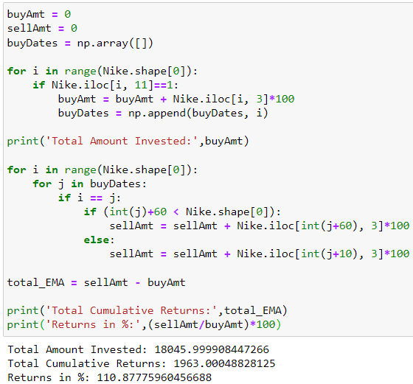
If we had followed this same strategy using EMA from 2018 till date, our total returns would be 110.87% i.e $10,000 invested using the same strategy would have generated $21,087 (as on 06/10/22).
We can also see here that EMA generated better results as compared to SMA. This is because EMA gives more weightage to recent prices while in SMA we calculate the average of all 'Close' prices over a period of time.

Slide 19
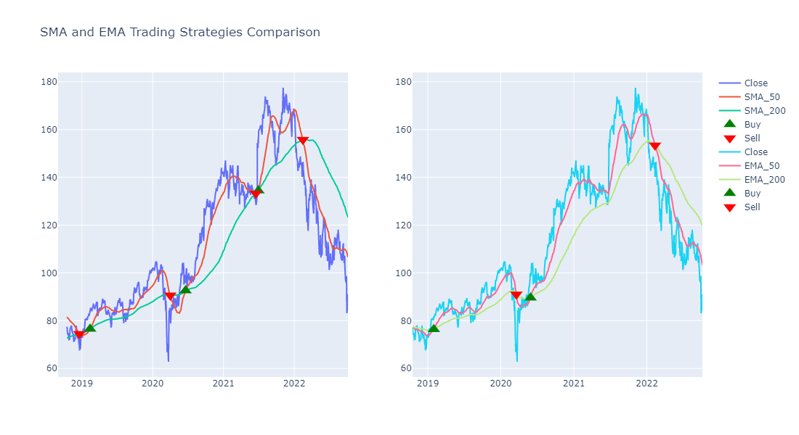
Comparison Between SMA and EMA Strategies

Slide 20
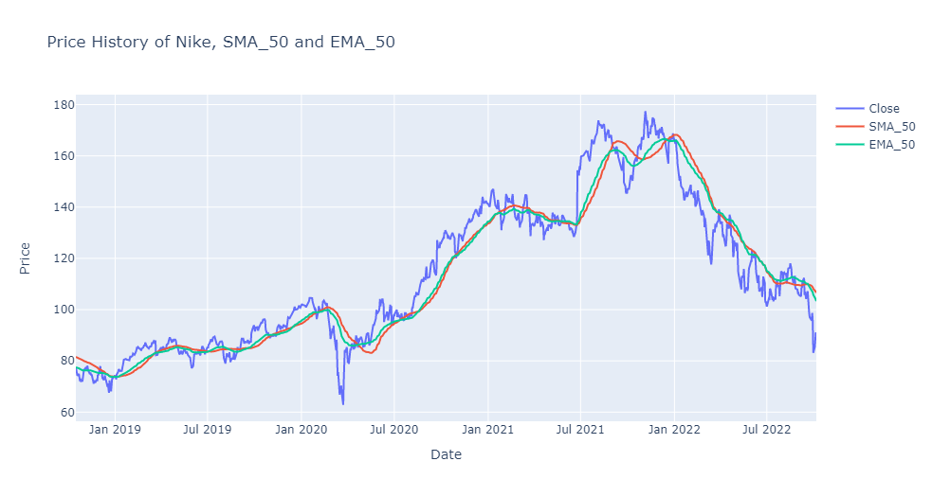
Price History of Nike, SMA_50 and EMA_50

Slide 21
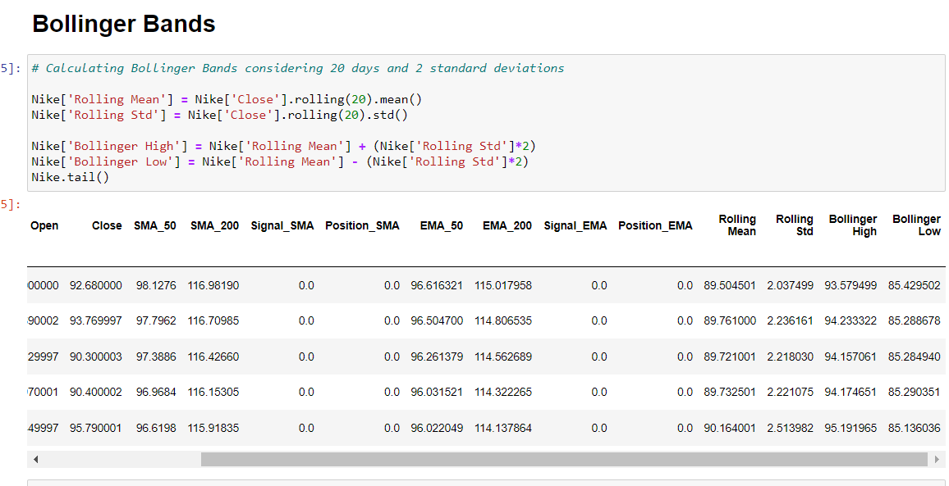
Bollinger Bands

Slide 22
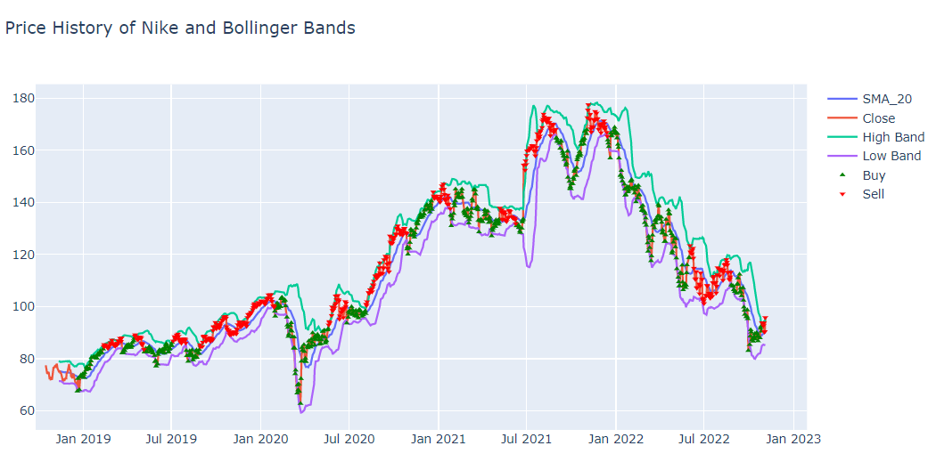
This is the plot for Trading Signals with Bollinger Bands
The Green Up indicates us to buy the stocks whereas the Red Down arrow indicates to sell the stocks
This Analysis says that up to which price of the stock we can buy and sell.

Slide 23
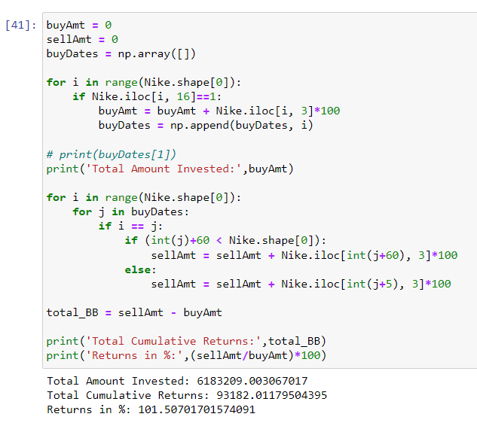
If we had followed this same strategy using Bollinger Bands from 2018 till date, our total returns would be 101.50% i.e $10,000 invested using the same strategy would have generated $20,150 (as on 06/10/22).

Slide 24
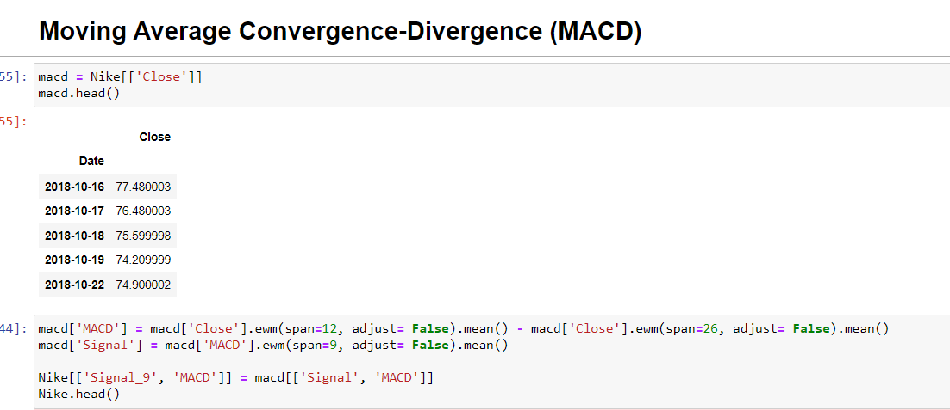
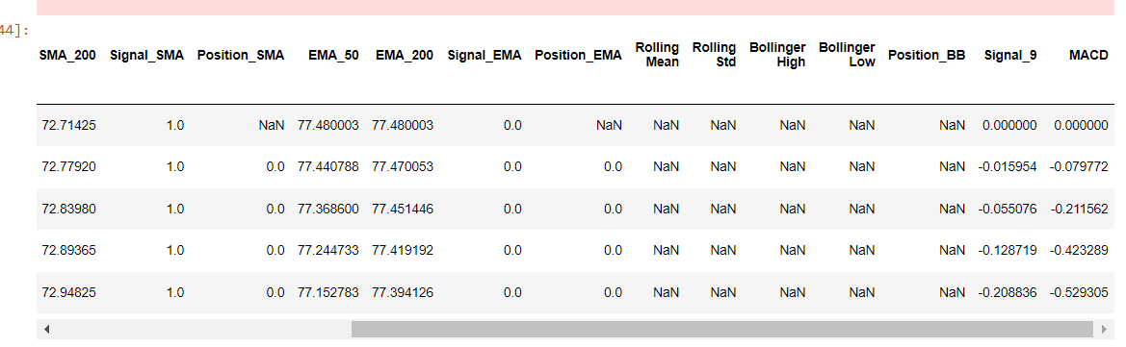
Moving Average Convergence-Divergence (MACD)

Slide 25
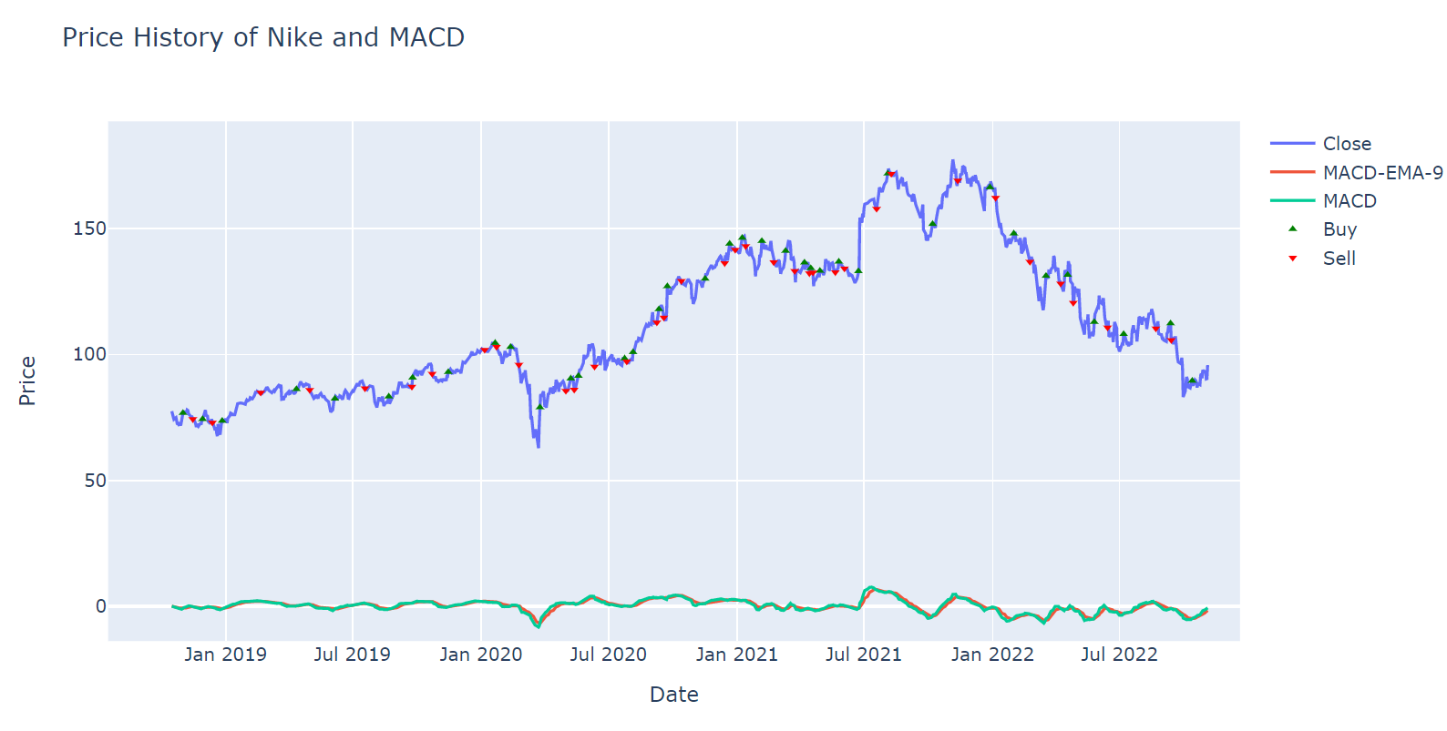
This is the plot for Trading Signals with MACD
The Green Up indicates us to buy the stocks whereas the Red Down arrow indicates to sell the stocks
This Analysis says that up to which price of the stock we can buy and sell.

Slide 26
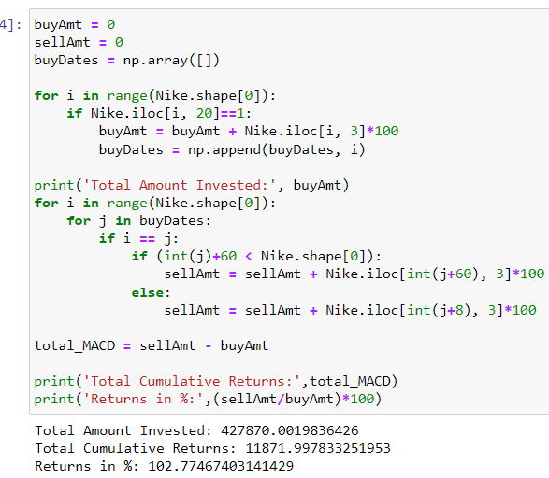
If we had followed this same strategy using MACD from 2018 till date, our total returns would be 102.77% i.e $10,000 invested using the same strategy would have generated $20,277 (as on 06/10/22).

Slide 27
Limitations
Technical analysis only works in a free market, and when the market is being manipulated, it's no longer free
In times of extreme fear or extreme optimism, don't expect technical analysis to help you earn any money
Technical analysis has the same limitation of any strategy based on particular trade triggers. The chart can be misinterpreted. The formation may be predicated on low volume. The periods being used for the moving averages may be too long or too short for the type of trade you are looking to make.
In some cases, one of the technical indicators will show a buy signal and another indicator will show a sell signal. This causes confusion in trading decisions.
For example, when a possible entry or exit point for a stock is suggested, it doesn’t guarantee a successful trade. Stock may decrease after the entry. Stock can also rise after the exit.

Slide 28
Thank you

